Slide 1

PROJECT 3 Group4
How countries' macroeconomic indicators affect Immigration to Canada

Slide 2
OBJECTIVE
How a country’s macroeconomic indicators affects Immigration to Canada
To visualize and explore different country macroeconomic indicators and assess whether or not it is a good indicator for immigration to Canada
To analyze how macro economic indicators impact immigration rates to Canada from different countries.
To identify trends and correlations between economic strength (measured by GDP) and immigration flows
To present insights visually and dynamically for better interpretation and decision-making.

Slide 3
DATA COLLECTION
Immigration data :
source : Immigration, refugees and citizenship of Canada
type : CSV file
Access : https://www.ircc.canada.ca/opendata-donneesouvertes/data/ODP-PR-Citz.csv
Macroeconomic data :
source : World bank
type : API
Access : https://api.worldbank.org/v2/country/XXX/indicator/XX.XXX.XXX.XX?date=XXXX:XXXX&format=json
We need an intermediate data to link the country name (in immigration data) and country code (used by the API)
type : API
Access : https://api.worldbank.org/v2/country?format=json

Slide 4
DATA CLEANING AND TRANSFORMATION
Merge dataframes
drop columns
data type conversion
replace empty values
replace NAN values
replace countries name : the names used in the 2 datasets do not match
identify the mismatch and manually create a mapping dictionary
replace 78 countries to be in line with World bank
rename columns
map months to get the numeric value (exp : mars : 3, apr : 4)
reset index
group by function to generate 2 df : immigration by country + immigration by country and by year

Slide 5
OUPUTS
csv : immigrants_by_country_monthly:
immigration statistics by country and by month from 2015 to 2024
(19,695 rows)
csv : macro_economic_data:
X selected indicators for each country and each year from 2015 to 2024
(38,557 rows)
csv : Countries_list_UN_referential
Gives additional information (region, coordinates, capital) that can help to additional analysis
218 rows

Slide 6
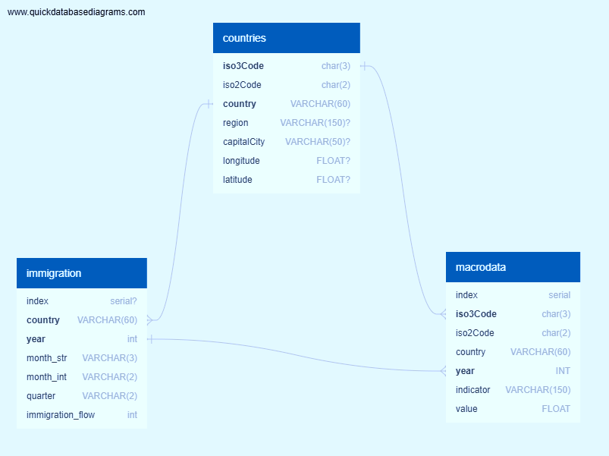
DATA BASE CREATION
Type : sqlite
Created by : SQLAlechemy
Source : csv files
use of declarative_base method
Content : 3 tables (countries, immigration, microdata)

Slide 7
FLASK API WITH JSON OUTPUT
use of “automap_base” method
create a server : http://127.0.0.1:5000 :
it describes the possibilities
create 6 routes to extract data
List of the countries available
List of the macro economic indicators available
immigation_flow_per_year_between 2015 and 2024 (filter the years)
immigation_flow_per_country
Immigration_statistics for all countries and all indicators
immigration_statistics_per_country (filter with the country code iso3 example : AGO for ANGLOA )

Slide 8
ANALYSIS AND VISUALIZATION'S
Create a DF that collect the linear regression result for all indicators against (immigration flow / total population)

Slide 9
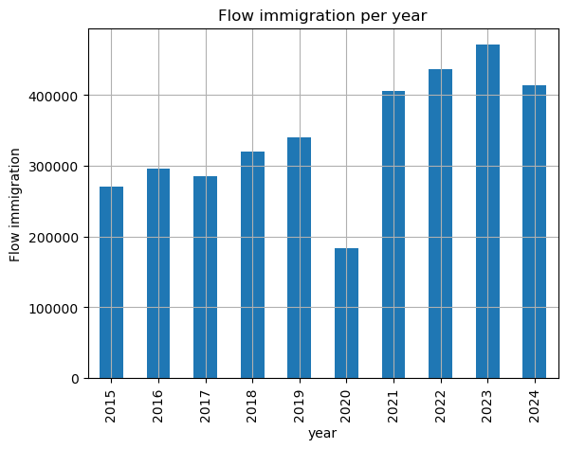
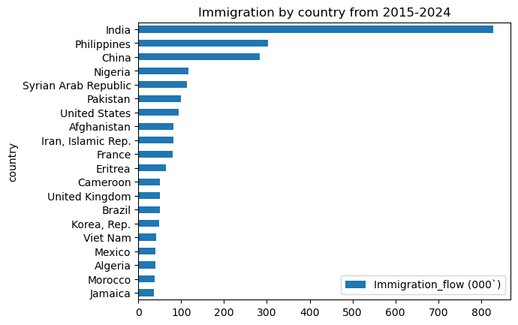
ANALYSIS AND VISUALIZATION'S
The data can be used to generate several visualizations
Available as png, gif, files
Available in HTML files

Slide 10
ANALYSIS AND VISUALIZATION'S
Create a race bar_chart
Library : bar_chart_race (pip install bar_chart_race)
Source : https://github.com/dexplo/bar_chart_race
documentation : https://www.dexplo.org/bar_chart_race/tutorial/

Slide 11
ANALYSIS AND VISUALIZATION'S

Slide 12
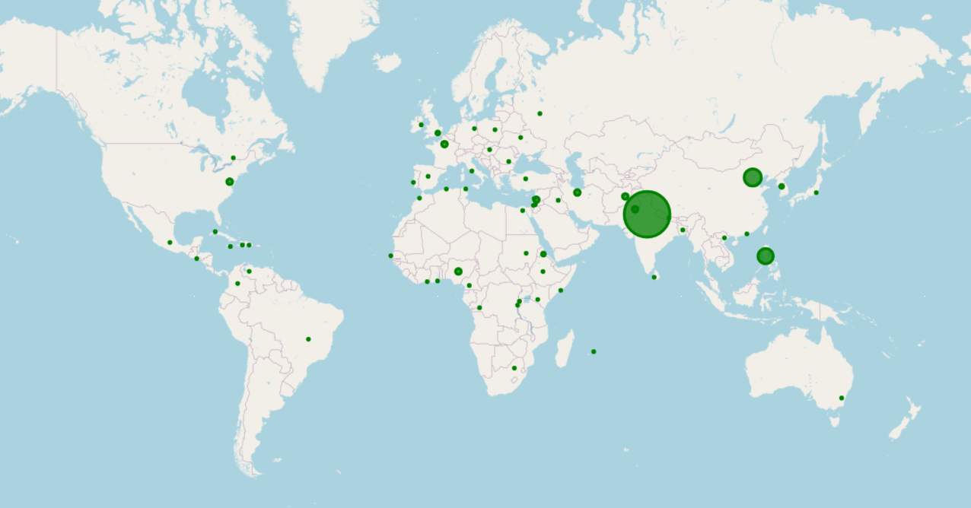
ANALYSIS AND VISUALIZATION'S
Leaflet immigration by country
Source route : http://127.0.0.1:5000/api/v0.1/immigation_flow_per_country

